Slide 1
Control Statements
Also called as control constructs
Need
Select between optional sections of a program
Repeat certain sections of a program.
True and False representation
False: value 0 is considered as false
True: Any value other than 0 is considered as true

Slide 2
Types
Program control statements/Constructs
Selection/ Branching
switch
Iteration/Looping
else if ladder
if else
if
while
for
do while

Slide 3
if statement
Test Condition
True
Syntax:
if(condition)
{
statement(s);
}
statement(s)
False
False
rest of the code
One – way decision / branching
The ‘statements’ can be any valid C language statement
‘condition’ is any valid C’ language expression, often logical operators are used in the condition statement
If the condition is true then perform the following statement or if the condition is false the computer skips the statement and moves on to the next instruction in the program

Slide 4
if statement - Example
#include<stdio.h>
int main()
{
int number;
printf("Enter a number:");
scanf("%d", &number);
if(number<0)
{
number= -number;
}
printf("The absolute value is %d",number);
return 0;
}
Output
Case 1:
Enter a number: -10
The absolute value is 10
Case 2:
Enter a number: 9
The absolute value is 9

Slide 5
if-else statement
Syntax:
if ( condition)
{ statement(s)_1;
}
else
{
statement(s)_2;
}
Test Condition
False
True
statement(s)
statement(s)
Two-way decision/branching
If the result of the condition is true, then program statement(s)_1 is executed, otherwise program statement(s)_2 will be executed

Slide 6
if else statement - Example
#include <stdio.h>
int main()
{
int number;
printf("Type a non zero number:");
scanf("%d",&number);
if(number>0){
printf("\nThe number is positive");
}
else{
printf("\nThe number is negative");
}
return 0;
}
Output
Case 1:
Type a non zero number: 60
The number is positive
Case 2:
Type a non zero number: -13
The number is negative

Slide 7
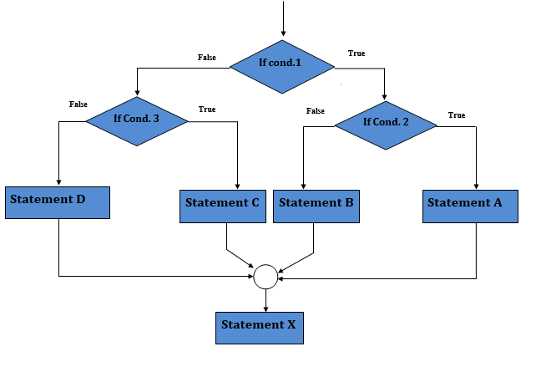
Nested if-else Statement
We can write an entire if…else statement in another if…else statement called nesting
Syntax:
if (condition1) {
statement(s);
if (condition2){ statement(s); }
else{ statement(s); }
}
else
{
statement(s);
if (condition3){ statement(s);
}
else{ statement(s); }
}

Slide 8
Nested if-else - Example
#include<stdio.h>
int main()
{
int a,b,c,big;
printf("Enter three different numbers:");
scanf("%d%d%d",&a,&b,&c);
if (a>b){
if(a>c)
{ big = a;}
else
{ big = c;}}
else{
if (b>c)
{big = b;}
else
{ big = c;}}
printf("Largest of %d %d %d is %d",a,b,c,big);
return 0;
}
Output:
Enter three different numbers:56 78 40
Largest of 56 78 40 is 78

Slide 9
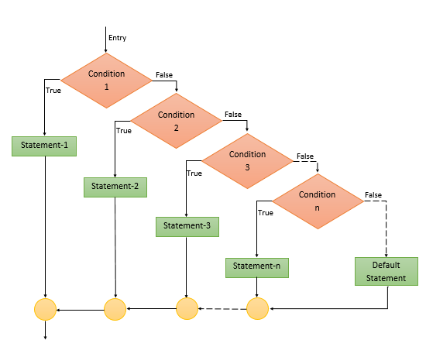
The else-if ladder
Syntax
if (condition_1)
{ statement(s)_1;
} else if (condition_2)
{ statement(s)_2;
} .
.
. else if (condition_n)
{ statement(s)_n;
} else
{ statement(s)_default;
}

Slide 10
The else-if ladder - Example
#include <stdio.h>
int main()
{
int marks;
printf ("Enter marks:");
scanf ("%d", &marks);
if (marks <= 100 && marks >= 70)
printf ("\nDistinction");
else if (marks >= 60)
printf("\nFirst class");
else if (marks >= 50)
printf ("\nSecond class");
else if (marks >= 35)
printf ("\nPass class");
else
printf ("Fail");
Return 0;
}
Output
Case 1:
Enter marks: 85
Distinction
Case 2:
Enter marks: 55
Second class
Case 3:
Enter marks: 20
Fail

Slide 11
Switch Statement
Allows a program to select one statement block for execution, out of a set of alternatives.
It checks for equality between the expression and the case value.
A switch may occur within another switch, but it is rarely done. Such statements are called nested switch statements.
The switch statement is very useful while writing menu-driven programs.

Slide 12
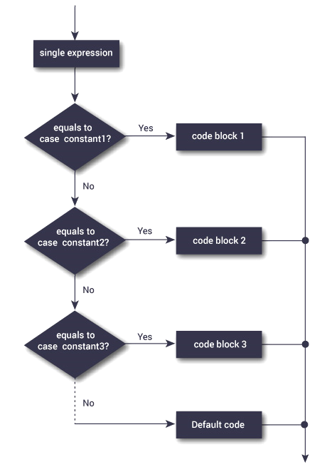
Switch Statement
Multiway decision or branching statement
Syntax
switch (expression) { case label-1: statement(s); break; case label-2: statement(s); break; case label-n: statement(s); break; ……………… default: statement(s); }

Slide 13
switch statement - Rules
The result of the expression in the switch statement must be an integer or character constant.
No real numbers are used in an expression.
The default is optional and can be placed anywhere, but usually placed at end.
The case keyword must be terminated with colon (:);
Case value specified in switch must be unique. i.e., No two case constant can be identical.
The values of switch expression is compared with case constant in the order specified i.e from top to bottom.
To denote the end of a particular case statement, break statement must be used.
Without break statement, the control flows from one case to the consecutive case
With break the control will go out of the switch block

Slide 14
Switch Statement- Calculator
case '*':
result = num1 * num2;
break;
case '/':
if (num2 != 0)
result = num1 / num2;
else
{
printf ("warning : division by zero \n");
result = 0;
}
break;
default:
printf ("\n unknown operator");
result = 0;
}
printf ("%d", result) ;
return 0;
}
#include <stdio.h>
int main ()
{
int num1, num2, result;
char operator;
printf ("Enter two numbers");
scanf ("%d %d", &num1, &num2);
printf ("Enter an operator") ;
scanf ("%c", &operator)
switch (operator)
{
case '+':
result = num1 + num2;
break;
case '-':
result = num1 - num2;
break;

Slide 15
Switch Statement- Example
#include <stdio.h>
int main ()
{
int number;
printf ("Enter a number: ");
scanf ("%d",&number);
switch(number%2)
{
case 0:
printf("Even");
break;
case 1:
printf("Odd");
break;
}
return 0;
}
Case1
Enter a number: 5
Odd
Case 2
Enter a number: 8
Even

Slide 16
Difference between nested if else and switch statements
Nested if else | switch
if-else statement can check any condition like equal to, less than, greater than or equal to, not equal to, etc .. | switch statement can check only for equality
Expression in if-else can result to a value of any data type | Expression in switch should result to either int data type or char data type value
More than one similar condition can be specified in if-else | Case value specified in switch must be unique
else statement at the end can be used to denote any condition other than specified previously. | default case can be used to denote any value other than specified previously

Slide 17
Looping / Iteration
Loop - A segment of the program that is executed repeatedly
Some portion of the program needs to be specified several times or until a particular condition is satisfied.
Types of looping statements in C
while loop
do…while loop
for loop

Slide 18
Looping / Iteration – contd…
Two parts:
Control expressions: One or more control expressions which control the execution of the loop
Body: which is the statement or set of statements which is executed over and over
Steps
Initialization of a condition variable
Test the control statement
Executing the body of the loop depending on the condition
Updating the condition variable

Slide 19
while statement
Syntax
while (expression/condition) { body of the loop;
increment control variable; }
Start
Initialize
Test Condition
False
Entry controlled loop statement
Expression or condition is evaluated, and the body of the loop is executed until the expression or condition becomes false.
When the expression or condition becomes false, the control is transferred out of the loop.
Stop
True
Body of Loop
updation of the control variable

Slide 20
while Statement - Example
Generating ‘N’ numbers using while loop:
#include<stdio.h>
void main()
{
int n, i=0;
printf("Enter the upper limit number:");
scanf("%d",&n);
while(i <= n)
{
printf(“\n%d",i);
i++;
}
}
Output:
Enter the upper limit number:6
0
1
2
3
4
5
6

Slide 21
do-while statement
Start
Syntax
do { body of the loop; } while(expression/condition);
Initialize
Body of Loop
Exit controlled loop statement
The statements in the body of the loop are executed first, and then the expression or condition is evaluated
If the condition or expression is true, then the body of the loop is executed again, and this process continues till the condition or expression becomes false
When the expression becomes false, the loop terminates, and the control is transferred out of the loop
Note: do while ends in a ; (semicolon)
updation of the control variable
Test Condition
True
False
Stop

Slide 22
do-while - Example
/* Program to illustrate the do-while loop*/
#include<stdio.h>
int main()
{
char inchar;
do
{
printf("Input y or n\n");
scanf(" %c",&inchar);
}while(inchar!='y' && inchar != 'n');
if(inchar=='y’){
printf("you pressed y\n");}
else{
printf("You pressed n\n");}
return 0;
}
Output:
Input y or n
a
Input y or n
b
Input y or n
r
Input y or n
y
you pressed y

Slide 23
“while” and “do…while” statement
while | do…while
entry controlled | exit controlled
Tests the condition before each iteration | Tests the condition after the first iteration.
If the condition fails initially, the loop is skipped entirely even in the first iteration. | Even if the condition fails initially, the body loop is executed once.

Slide 24
for loop
Syntax:
for (initialization; expression /condition; updation of control variable) { body of the loop ; }
Start
Initialize
Used to execute a set of instructions repeatedly until the expression or condition becomes false.
Test Condition
False
Stop
True
Body of Loop
updation of the control variable

Slide 25
for loop – Example
#include<stdio.h>
int main()
{
int i;
int sum=0,sum_of_squares=0;
for(i=0; i<=30; i+=2)
{
sum+=i;
sum_of_squares +=i*i;
}
printf("Sum of first 15 positive even numbers=%d\n",sum);
printf("Sum of their squares=%d\n",sum_of_squares);
return 0;
}
Output:
Sum of first 15 positive even numbers=240
Sum of their squares=4960

Slide 26
Additional Features of for Loop
Note 1:
The statement
p = 1;
for (n = 0; n < 17; ++ n)
can be rewritten as
for (p = 1, n = 0; n < 17;++n)
Note 2:
The test – condition may have any compound relation and the testing need not be limited only to the loop control variable.
sum = 0;
for (i = 1; i < 20 && sum < 100; ++ i)
{
sum = sum + i;
printf(“%d %d\n”, i, sum);
}

Slide 27
Additional Features of for Loop Contd…
Note 3:
It is also permissible to use expressions in the assignment statements of initialization and updation sections.
For Example:
for (x = (m + n) / 2; x > 0; x = x / 2)
Note 4:
Another unique aspect of for loop is that one or more sections can be omitted, if necessary.
For Example:
m = 5;
for ( ; m ! = 100 ;) {
printf(“%d\n”,m);
m = m + 5;
}

Slide 28
Note 4 contd..
for(;;) – Infinite loop
Both the initialization and increment sections are omitted in this for statement.
The initialization has been done before the for statement and the control variable is incremented inside the loop. In such cases, the sections are left ‘blank’.
However, the semicolons separating the sections must remain. If the test – condition is not present, then the for statement sets up an ‘infinite’ loop.
Such loops can be broken using break or goto statements in the loop.

Slide 29
Additional Features of for Loop Contd…
Note 5:
We can set up time delay loops using the null statement as follows:
for ( j = 1000; j > 0; j = j – 1)
;
This loop is executed 1000 times without producing any output; it simply causes a time delay.
Notice that the body of the loop contains only a semicolon, known as a null statement.
Note 6:
for ( j = 1000; j > 0; j = j – 1);
This implies that the C compiler will not give an error message if we place a semicolon by mistake (or consciously as in the case 5) at the end of a for statement. The semicolon will be considered as a null statement.

Slide 30
Nested loops
Syntax:
Outer_loop
{
Inner_loop
{
// inner loop statements.
}
// outer loop statements.
}
The looping of statements inside another loop
Any number of loops can be defined inside another loop
Any type of loop can be defined inside another loop
For within for, for within while, do-while within while, etc..

Slide 31
Nested loops - Example
while(condition)
{
do
{
inner loop statement(s);
}
while(condition) ;
outer loop statement(s);
}
for(initialization;condition; updation)
{
while(condition)
{
inner loop statement(s);
}
outer loop statement(s);
}

Slide 32
break and continue statements
The break statement is used to break any type of loop (while, do-while and for loop) or case in a switch statements
break statement terminates the loop body immediately
The break statement causes the control to transfer out of the entire switch statement.
The continue statement is used to break the current iteration of the loop by skipping the remaining part of the loop
After continue statement, the control returns to the start of the loop for next iteration
Both break and continue statements does not have any embedded expression or arguments.

Slide 33
break - Example
#include<stdio.h>
int main()
{
int i;
for(i=0; i<10;i++)
{
if(i==4)
break;
printf("%d\n", i);
}
return 0;
}
This program comes out of the loop when i equals 4
Output:
0
1
2
3

Slide 34
continue - Example
#include<stdio.h>
int main()
{
int i=0;
while(i<10)
{
if(i==4)
{
i++;
continue;
}
printf("%d\n",i);
i=i+1;
}
return 0;
}
Output:
0
1
2
3
5
6
7
8
9

Slide 35
break and continue - Difference
break | continue
It is used in loop and switch case | It is used in loops and not in switch case
It is used to terminate from the loop | It is used to continue to the next iteration in the loop
Control is transferred outside the loop | Control remains in the same loop

Slide 36
goto statement
The goto statement is used to transfer the program control from one statement to another statement
A statement label is used which is followed by colon ( : )
Types
Unconditional goto
Conditional goto
Syntax:
goto <<label_name>>;
…..
…..
label:
statement(s);

Slide 37
goto statement - Example
conditional goto
The control transfers from one block to another block with checking the test condition.
#include<stdio.h>
void main()
{
int n, sum = 0, i = 0;
printf ("Enter a number:");
scanf ("%d", &n);
xyz:
i++;
sum += i;
if (i < n) goto xyz;
printf ("\nSum of first %d natural numbers = %d", n, sum);
}
unconditional goto
The control transfers from one block to another block without checking the test condition.
#include <stdio.h>
main()
{
Start:
printf("Welcome\n");
goto Start;
}

